Slide 1
Requirements Collection
Prepared by
V.Arulkumar

Slide 2
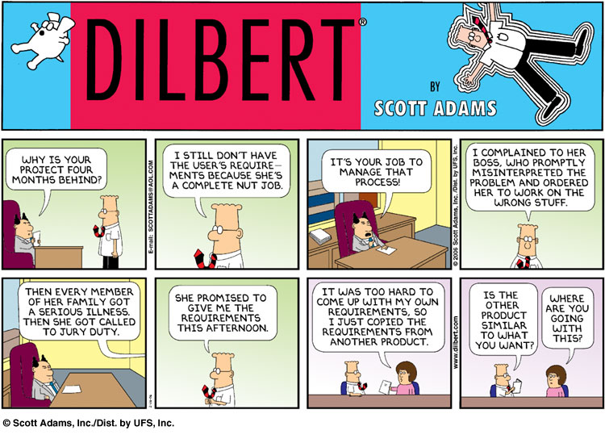

Slide 3

Roadmap
The Requirements Engineering Process
Use Cases
Functional and non-functional requirements
Evolutionary and throw-away prototyping
Requirements checking and reviews

Slide 4
Sources
Software Engineering, I. Sommerville, 7th Edn., 2004.
Software Engineering — A Practitioner’s Approach, R. Pressman, Mc-Graw Hill, 5th Edn., 2001.
Objects, Components and Frameworks with UML, D. D'Souza, A. Wills, Addison-Wesley, 1999

Slide 5
Roadmap
The Requirements Engineering Process
Use Cases
Functional and non-functional requirements
Evolutionary and throw-away prototyping
Requirements checking and reviews

Slide 6
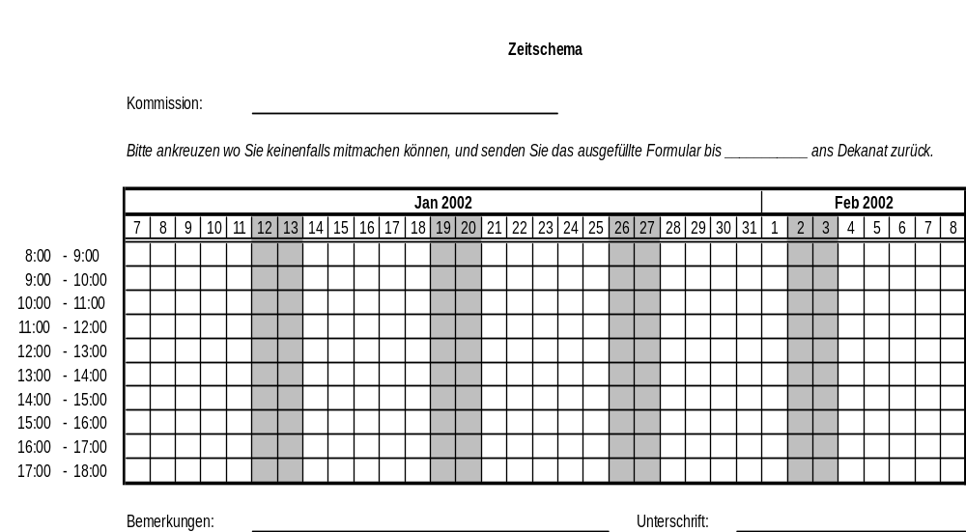

Slide 7
Requirements Engineering
The process of establishing
  the services that are required of the system, and
  the constraints under which it operates and is developed
The requirements themselves are the descriptions of both of these items.
Notes:
Spend 10-15 minutes identifying the actors, the use cases, scenarios, technical & non-technical requirements, risks etc.

Slide 8
Who’s Who?
Who’s Who?
Client – the person(s) paying for the development and will become the owner of the product
Customer – the person who will buy the product off the shelf (mass marketing), or who has the final say as to whether the product is acceptable (in-house development). May be the same as the client
Stakeholder – anyone who should have some direct or indirect influence on the system requirements
Reference: Mastering the Requirements Process, Robertson and Robertson

Slide 9
Types of Requirements
User requirements
  Should describe requirements so that they are understandable by those who do not have detailed technical knowledge. Written mainly for customers (end users)
System requirements
  A structured document setting out detailed descriptions of the system services and constraints. Written as a contract between client and contractor
Software design specification
  An abstract description of the software design that can serve as a basis for a more detailed design. Bridges the gap between requirements and design. Written for developers

Slide 10
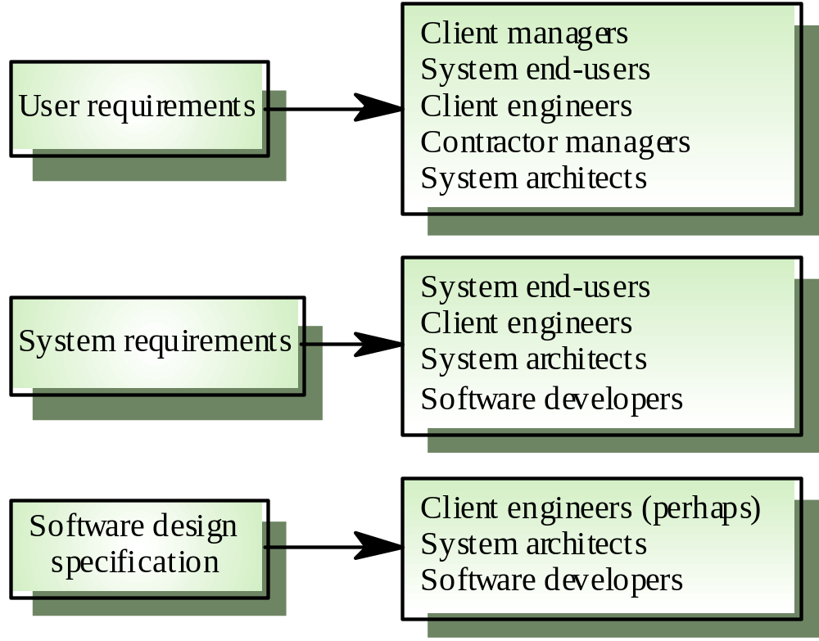
Requirements Readers

Slide 11
Functional and Non-functional Requirements
Functional requirements
  Statements of services the system should provide, how the system should react to particular inputs, and how the system should behave in particular situations
Non-functional requirements
  Constraints on the services or functions offered by the system such as timing constraints, constraints on the development process, standards, etc.

Slide 12
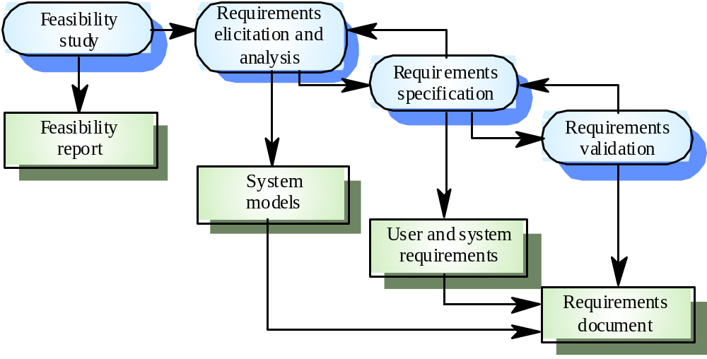
The Requirements Engineering Process
© Ian Sommerville 2000
Notes:
Ch6 p 122

Slide 13
Requirements Engineering Activities
Feasibility study | Determine if the user needs can be satisfied with the available technology and budget.
Requirements analysis | Find out what system stakeholders require from the system.
Requirements definition | Define the requirements in a form understandable to the customer.
Requirements specification | Define the requirements in detail. (Written as a contract between client and contractor.)
“Requirements are for users; specifications are for analysts and developers.”

Slide 14
Requirements Analysis
Sometimes called requirements elicitation or requirements discovery
Technical staff work with customers to determine
the application domain,
the services that the system should provide and
the system’s operational constraints.
Involves various stakeholders:
e.g., end-users, managers, engineers involved in maintenance, domain experts, trade unions, etc.

Slide 15
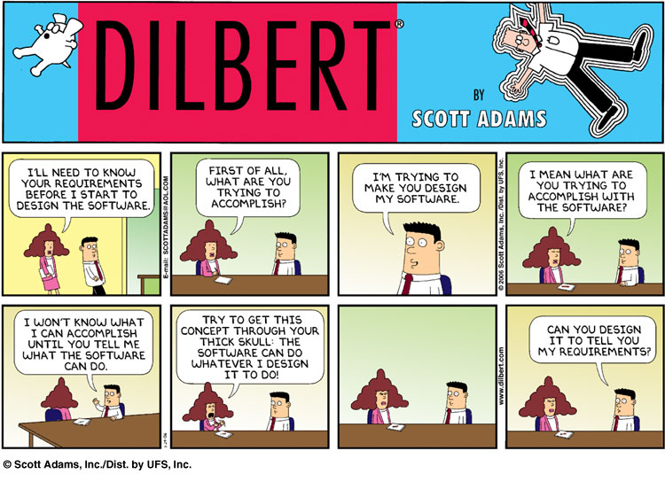
http://en.wikipedia.org/wiki/Fair_use

Slide 16
Problems of Requirements Analysis
Various problems typically arise:
  Stakeholders don’t know what they really want
  Stakeholders express requirements in their own terms
  Different stakeholders may have conflicting requirements
  Organisational and political factors may influence the system requirements
  The requirements change during the analysis process.
  New stakeholders may emerge.

Slide 17
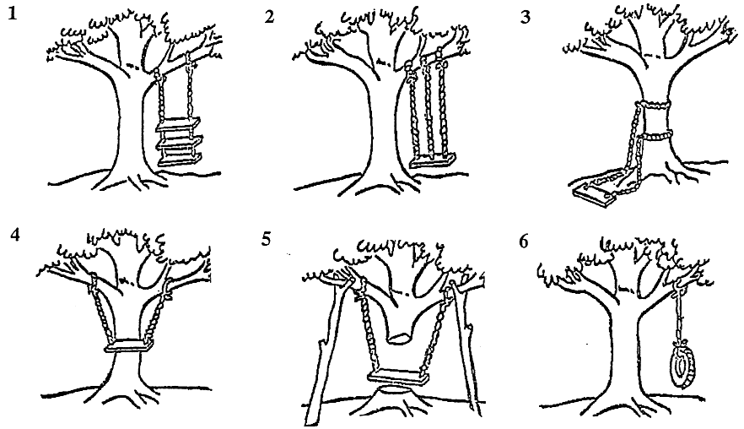
Impedance Mismatches
As Management requested it
As the Project Leader defined it
As Systems designed it
As Programming developed it
As Operations installed it
What the User wanted

Slide 18
Requirements evolution
Requirements always evolve as a better understanding of user needs is developed and as the organisation’s objectives change
It is essential to plan for change in the requirements as the system is being developed and used

Slide 19
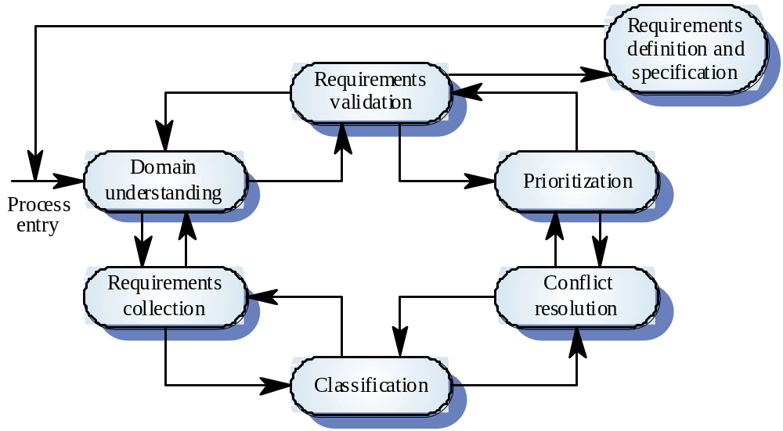
The Requirements Analysis Process
© Ian Sommerville 2000
Notes:
Ch6 p 125.
Domain understanding: gather & understand domain knowledge
Collection: by interaction w stakeholders
Classification: into coherent clusters
Conflict resolution: ie due to different stakeholders
Prioritization: ie importance, value …
Validation: checking consistency, completeness …

Slide 20
Roadmap
The Requirements Engineering Process
Use Cases
Functional and non-functional requirements
Evolutionary and throw-away prototyping
Requirements checking and reviews

Slide 21
Use Cases and Scenarios
A use case is the specification of a sequence of actions, including variants, that a system (or other entity) can perform, interacting with actors of the system”.
  e.g., buy a DVD through the internet
A scenario is a particular trace of action occurrences, starting from a known initial state.
  e.g., connect to myDVD.com, go to the “search” page
...

Slide 22
Use Cases and Viewpoints ...
Stakeholders represent different problem viewpoints.
  Interview as many different kinds of stakeholders as possible/necessary
  Translate requirements into use cases or “stories” about the desired system involving a fixed set of actors (users and system objects)
  For each use case, capture both typical and exceptional usage scenarios
Users tend to think about systems in terms of “features”.
  You must get them to tell you stories involving those features.
  Use cases and scenarios can tell you if the requirements are complete and consistent!

Slide 23
Unified Modeling Language
UML is the industry standard for documenting OO models
Class Diagrams | visualize logical structure of system in terms of classes, objects and relationships
Use Case Diagrams | show external actors and use cases they participate in
Sequence Diagrams | visualize temporal message ordering of a concrete scenario of a use case
Collaboration (Communication) Diagrams | visualize relationships of objects exchanging messages in a concrete scenario
State Diagrams | specify the abstract states of an object and the transitions between the states

Slide 24
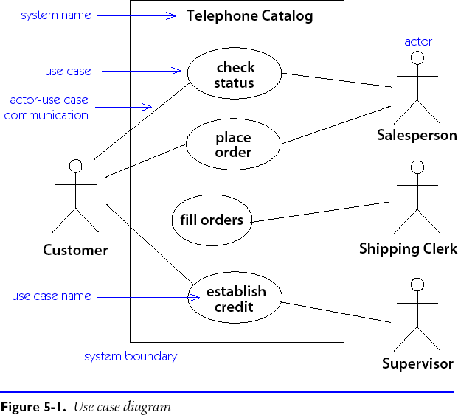
Use Case Diagrams
More on this later …

Slide 25
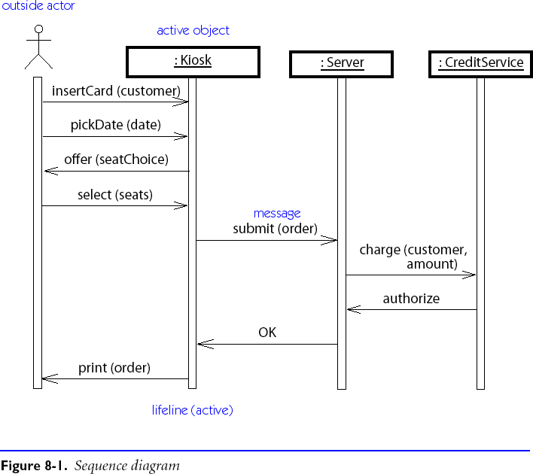
Sequence Diagrams

Slide 26
Writing Requirements Definitions
Requirements definitions usually consist of natural language, supplemented by (e.g., UML) diagrams and tables.
Three types of problems can arise:
  Lack of clarity: It is hard to write documents that are both precise and easy-to-read.
  Requirements confusion: Functional and non-functional requirements tend to be intertwined.
  Requirements amalgamation: Several different requirements may be expressed together.

Slide 27
Roadmap
The Requirements Engineering Process
Use Cases
Functional and non-functional requirements
Evolutionary and throw-away prototyping
Requirements checking and reviews

Slide 28
Functional and Non-functional Requirements
Functional requirements describe system services or functions
  Compute sales tax on a purchase
  Update the database on the server ...
Non-functional requirements are constraints on the system or the development process
  Non-functional requirements may be more critical than functional requirements.
  If these are not met, the system is useless!

Slide 29
Functional Requirements
Describe functionality or system services
These services depend on
  the type of software being developed
  the expected users of the software
Functional user requirements may be high-level statements of what the system should do, but functional system requirements should describe the system services in detail.

Slide 30
Functional Requirement Examples
The user shall be able to add or delete problems to/from the problem collection.
The user shall be able to preview an examination on the monitor.
A student shall be able to take an examination on-line.
The system will automatically grade an examination upon completion by the student.

Slide 31
Non-functional Requirements
Define system properties and constraints
Examples:
  response time
  storage requirements
  process requirements (e.g., must use a particular CASE system, programming language, or development method)
Non-functional requirements may be more critical than functional requirements. If one is not met, the system may be useless.

Slide 32
Non-functional Requirements Examples
Product requirements
  - An examination shall accommodate true/false, multiple choice, and short answer questions.
  An exam question and the space for its answer must not be divided between two printed pages.
  - The system must run under Red Hat Linux, Version 6.2.
  - The system must be written in C++, compilable using Microsoft Visual C++, Version 6.0.

Slide 33
More Non-functional Requirements
User interface requirements
  The user interface shall be text-based.
  The user interface shall be menu-driven.
  The UMBC logo shall always be displayed in the upper right-hand corner of the screen.

Slide 34
More Non-functional Requirements
Organizational requirements
  The system development process and deliverable documents shall conform to the process and deliverables defined in XYZCo-SP-STAN-95.
External requirements
  The system shall not disclose any personal information about customers apart from their name and reference number to the operators of the system.

Slide 35
Non-functional Requirements
Product requirements: | specify that the delivered product must behave in a particular way e.g. execution speed, reliability, etc.
Organisational requirements: | are a consequence of organisational policies and procedures e.g. process standards used, implementation requirements, etc.
External requirements: | arise from factors which are external to the system and its development process e.g. interoperability requirements, legislative requirements, etc.

Slide 36
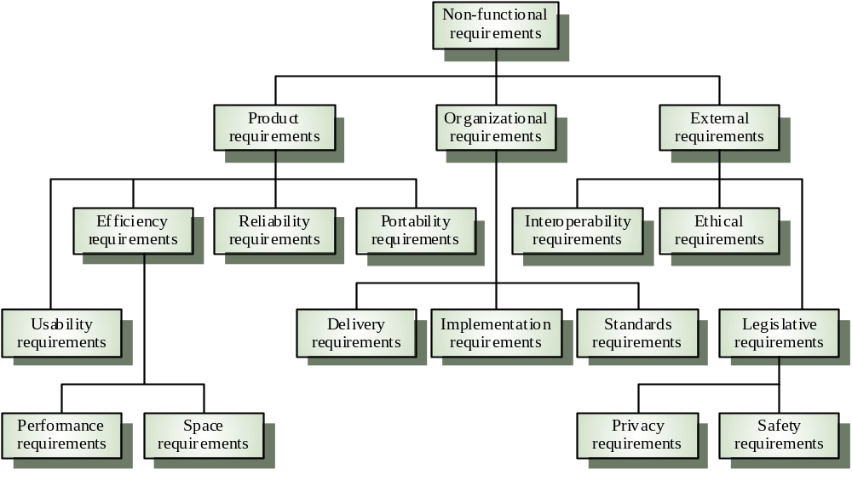
Types of Non-functional Requirements
© Ian Sommerville 2000
Notes:
ch5

Slide 37
Examples of Non-functional Requirements
Product requirement | It shall be possible for all necessary communication between the APSE and the user to be expressed in the standard Ada character set.
Organisational requirement | The system development process and deliverable documents shall conform to the process and deliverables defined in XYZCo-SP-STAN-95.
External requirement | The system shall provide facilities that allow any user to check if personal data is maintained on the system. A procedure must be defined and supported in the software that will allow users to inspect personal data and to correct any errors in that data.

Slide 38
Requirements Verifiability
Requirements must be written so that they can be objectively verified.
Imprecise:
  The system should be easy to use by experienced controllers and should be organised in such a way that user errors are minimised.
  Terms like “easy to use” and “errors shall be minimised” are useless as specifications.
Verifiable:
  Experienced controllers should be able to use all the system functions after a total of two hours training. After this training, the average number of errors made by experienced users should not exceed two per day.

Slide 39
Precise Requirements Measures (I)
Property | Measure
Speed | Processed transactions/second User/Event response time Screen refresh time
Size | K Bytes; Number of RAM chips
Ease of use | Training time Rate of errors made by trained users Number of help frames

Slide 40
Precise Requirements Measures (II)
Property | Measure
Reliability | Mean time to failure Probability of unavailability Rate of failure occurrence
Robustness | Time to restart after failure Percentage of events causing failure Probability of data corruption on failure
Portability | Percentage of target dependent statements Number of target systems

Slide 41
Roadmap
The Requirements Engineering Process
Use Cases
Functional and non-functional requirements
Evolutionary and throw-away prototyping
Requirements checking and reviews

Slide 42
Prototyping Objectives
The objective of evolutionary prototyping is to deliver a working system to end-users.
  Development starts with the requirements that are best understood.
The objective of throw-away prototyping is to validate or derive the system requirements.
  Prototyping starts with that requirements that are poorly understood.22

Slide 43
Evolutionary Prototyping
Must be used for systems where the specification cannot be developed in advance.
  e.g., AI systems and user interface systems
Based on techniques which allow rapid system iterations.
  e.g., executable specification languages, VHL languages, 4GLs, component toolkits
Verification is impossible as there is no specification.
  Validation means demonstrating the adequacy of the system.

Slide 44
Throw-away Prototyping
Used to reduce requirements risk
  The prototype is developed from an initial specification, delivered for experiment then discarded
The throw-away prototype should not be considered as a final system
  Some system characteristics may have been left out
  (e.g., platform requirements may be ignored)
  There is no specification for long-term maintenance
  The system will be poorly structured and difficult to maintain

Slide 45
Roadmap
The Requirements Engineering Process
Use Cases
Functional and non-functional requirements
Evolutionary and throw-away prototyping
Requirements checking and reviews

Slide 46
Requirements Checking
Validity | Does the system provide the functions which best support the customer’s needs?
Consistency | Are there any requirements conflicts?
Completeness | Are all functions required by the customer included?
Realism | Can the requirements be implemented given available budget and technology?

Slide 47
Requirements Reviews
Regular reviews should be held while the requirements definition is being formulated
Both client and contractor staff should be involved in reviews
Reviews may be formal (with completed documents) or informal.
  Good communications between developers, customers and users can resolve problems at an early stage

Slide 48
Review checks
Verifiability | Is the requirement realistically testable?
Comprehensibility | Is the requirement properly understood?
Traceability | Is the origin of the requirement clearly stated?
Adaptability | Can the requirement be changed without a large impact on other requirements?

Slide 49
Traceability
To protect against changes you should be able to trace back from every system component to the original requirement that caused its presence
 | C1 | C2 | … | … | Cm
req1 |  | x
req2 | x
… |  |  |  | x
… |  |  |  |  | x
reqn |  | x | x
A software process should help you keep this virtual table up-to-date
Simple techniques may be quite valuable (naming conventions, ...)

Slide 50
What you should know!
What is the difference between requirements analysis and specification?
Why is it hard to define and specify requirements?
What are use cases and scenarios?
What is the difference between functional and non-functional requirements?
What’s wrong with a requirement that says a product should be “user-friendly”?
What’s the difference between evolutionary and throw-away prototyping?

Slide 51
Can you answer the following questions?
Why isn’t it enough to specify requirements as a set of desired features?
Which is better for specifying requirements: natural language or diagrams?
How would you prototype a user interface for a web-based ordering system?
Would it be an evolutionary or throw-away prototype?
What would you expect to gain from the prototype?
How would you check a requirement for “adaptability”?

